Slide 1
Introduction to R/R Studio: Dplyr/Tidyverse
Smart-R workshop series
Olivia Boyd
o.boyd@imperial.ac.uk
Notes:
30 minutes

Slide 2
Recap
Previous section focused on:
The console, data objects and functions, base-r (+, -, *, /, etc.)
This section:
Manipulating data, using script, cleaning data
Basic plots
Ready? Let’s get started. Open practical 2 in Rstudio.

Slide 3
Install packages and loading packages
install.packages() is used to download new packages into R
These packages provide new functions to be used that don’t exist in base R, have been created by other users.
Everytime you open R, you have to reload packages that you have installed prior, using library()
OR if using new packages never before installed, then install with install.packages() and then load new packages with library()
install.packages(dplyr)
library(dplyr)

Slide 4
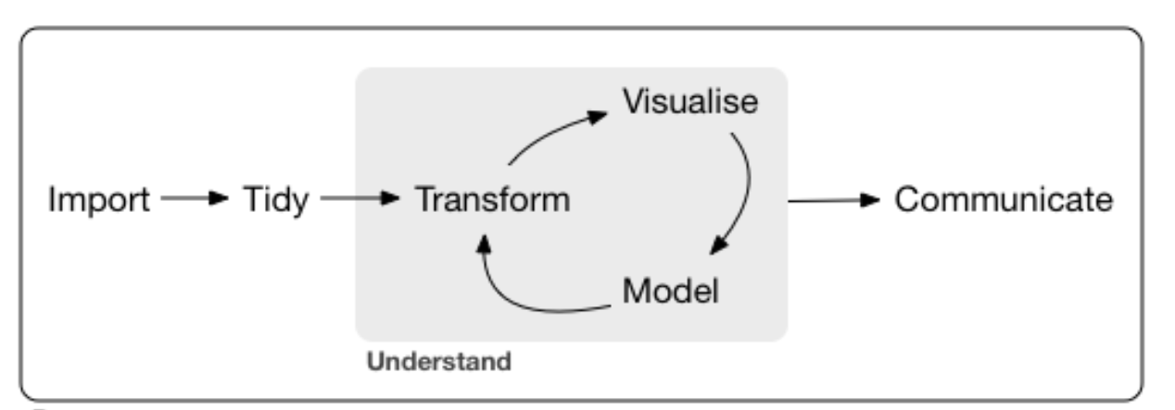
Tidyverse/dplyr
Collection of tools for manipulating and visualizing data
Today: dplyr(filter, arrange, mutate, group_by) and ggplot2 (graphics)

Slide 5
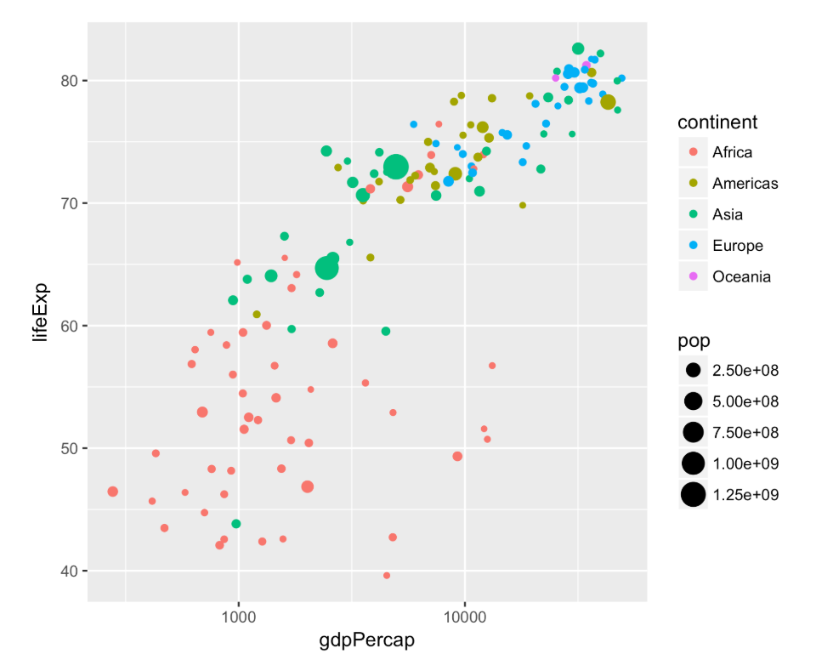
Gapminder dataset
Social and economic indicators by country and year including life expectancy, population size and gross domestic product per capita
Gdp per capita = total economic output / population
Country and continent are factor (categorical) variables, repeating variables (e.g. Afghanistan occurs more than once).

Slide 6
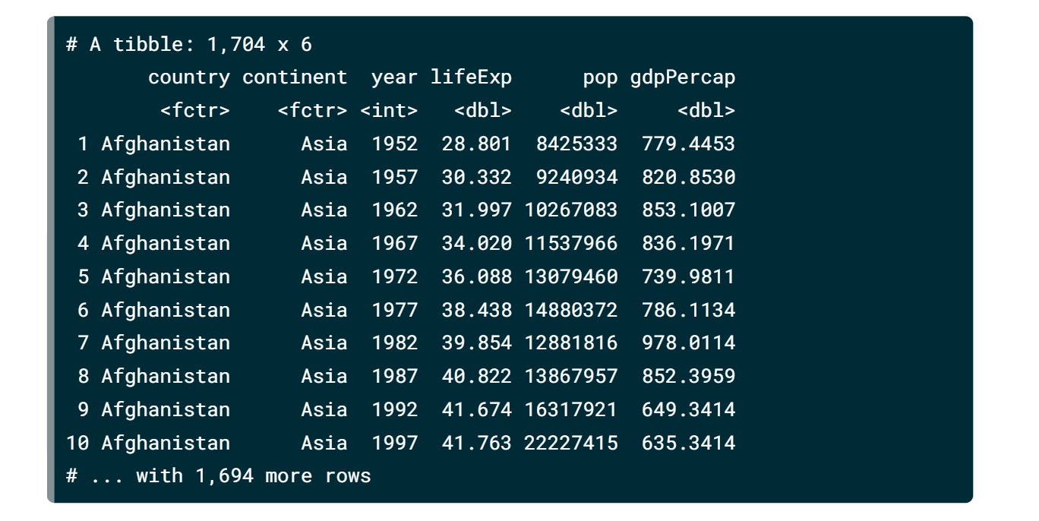
Gapminder dataset
Observations vs. rows, dataframe format
Each row represents unique pair of country and year
Each variable has a consistent datatype
E.g. numbers, like life expectancy or population, vs. categorical, like country or continent.

Slide 7
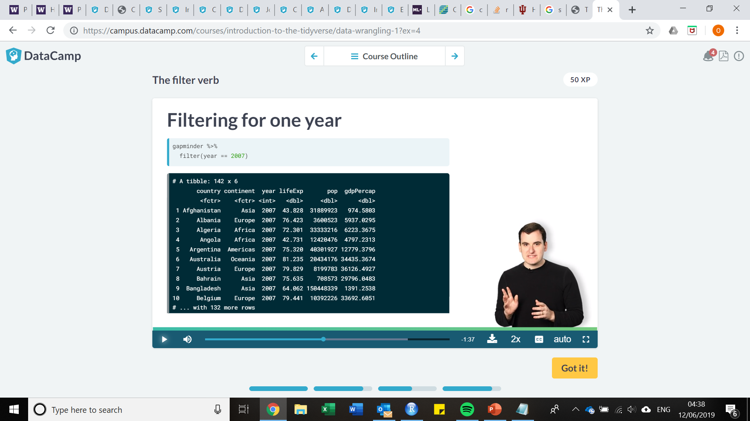
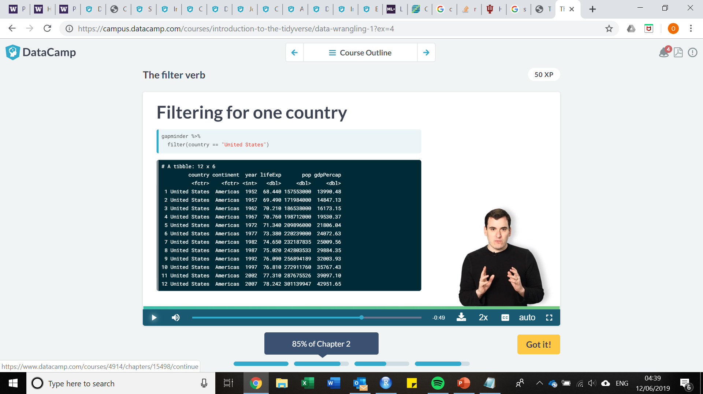
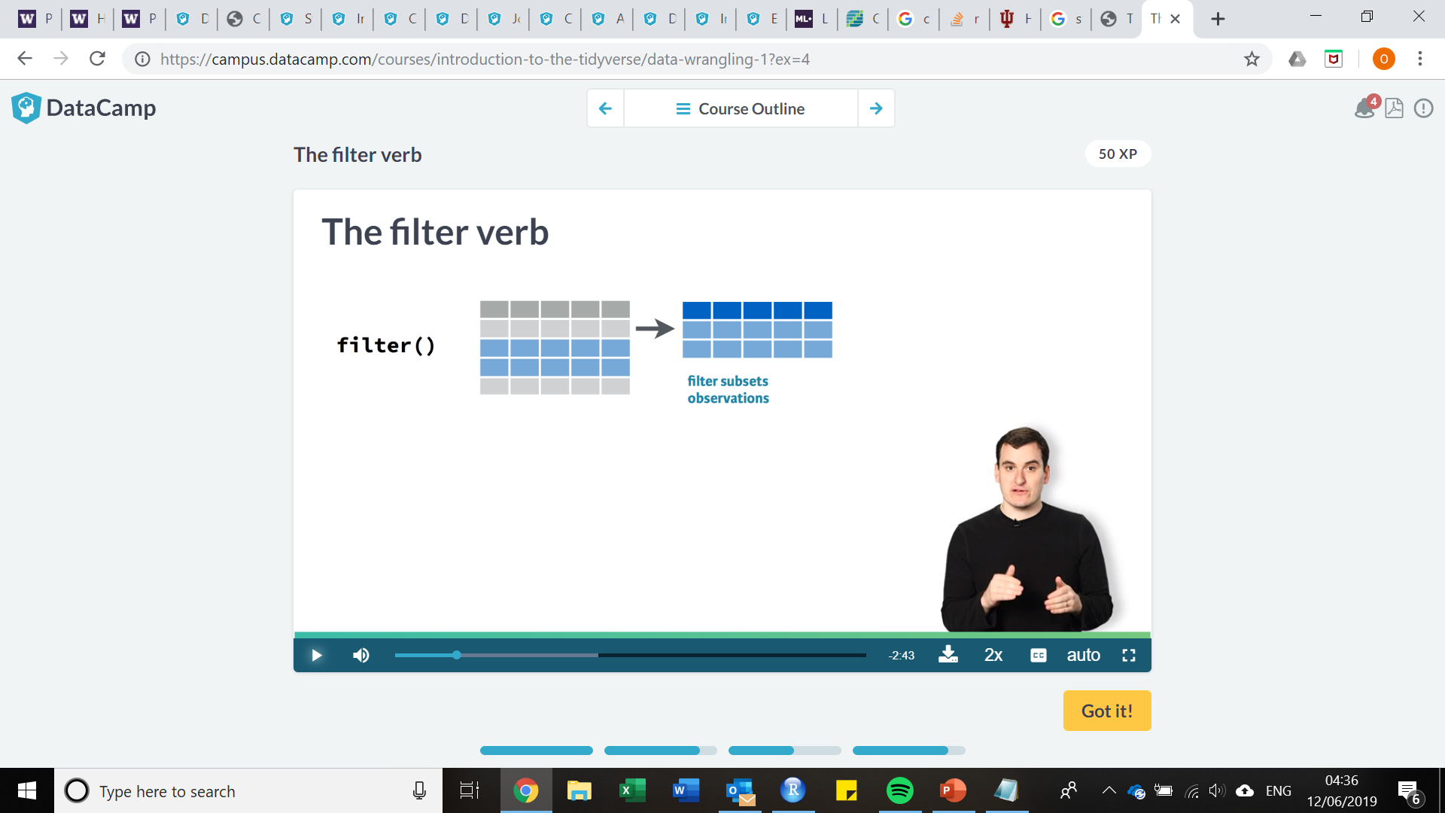
Dplyr: The filter verb
Looking at a subset of observations, based on a particular condition

Slide 8
Dplyr: the filter verb
Looking at a subset of observations, based on a particular condition

Slide 9
Dplyr: the filter verb
Looking at a subset of observations, based on a particular condition, uses %>%

Slide 10
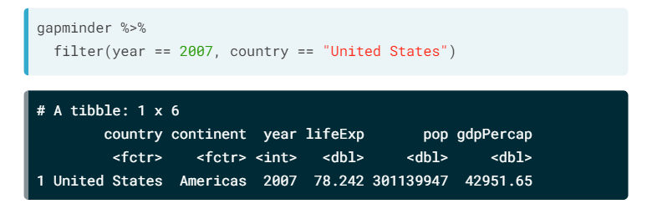
Dplyr: the filter verb
Looking at a subset of observations, based on a particular condition
You can specify multiple conditions within a filter.

Slide 11
Dplyr: the filter verb
Looking at a subset of observations, based on a particular condition
You can specify multiple conditions within a filter.
The & symbol, same as a ,
The | symbol, like or in a condition
Both are used often in R

Slide 12
Dplyr: the filter verb
Looking at a subset of observations, based on a particular condition
You can specify multiple conditions within a filter.
E.g. filter(year == 2007 & country == “United Kingdom”) vs. filter(year == 2007 | country == “United Kingdom) return different observations

Slide 13
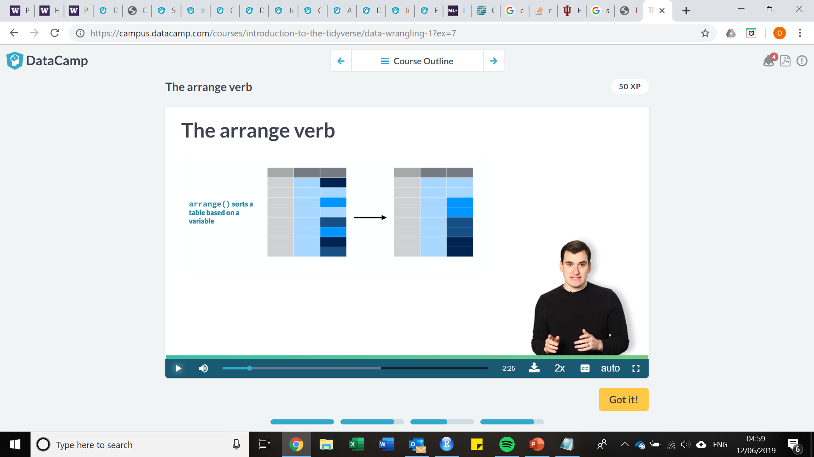

Dplyr: the arrange verb
Sorts variables in a dataset, either in ascending order with arrange() or descending order with arrange(desc())
Useful if you want to know minimum or maximum values in dataset

Slide 14

Dplyr: the arrange verb
Sorts variables in a dataset, either in ascending order with arrange() or descending order with arrange(desc())
Useful if you want to know minimum or maximum values in dataset

Slide 15

Dplyr: the arrange verb
Sorts variables in a dataset, either in ascending order with arrange() or descending order with arrange(desc())
Useful if you want to know minimum or maximum values in dataset
Combining dplyr verbs in piping allows you to look more specifically within data

Slide 16


Dplyr: the mutate verb
To change a variable or create a new variable, based on data available in dataframe

Slide 17

Combining verbs together
Country with highest total gdp in 2007?
Lets go to practical 2!

Slide 18
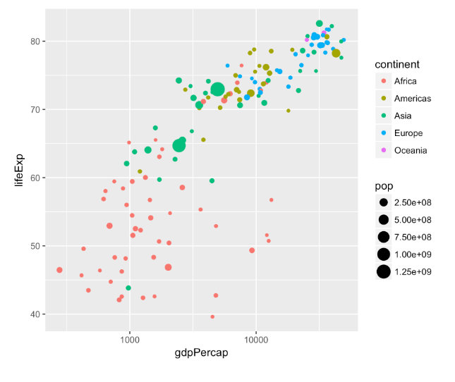
Data visualization: introduction
Often useful to visualize when looking at larger datasets
Visualisation and data cleaning go hand in hand!
Utilise both when first diving into data!
Now we will save the manipulating in dataframes using the assignment operator, <-

Slide 19
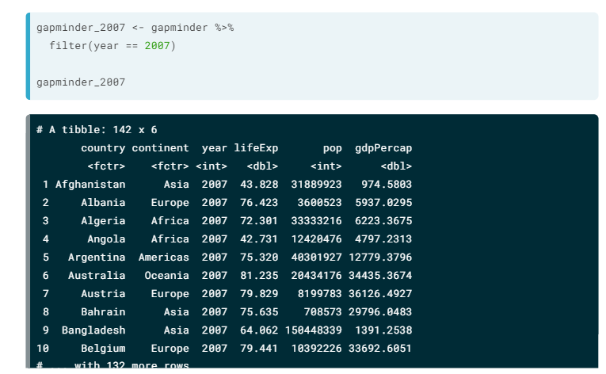
Data visualization: introduction
E.g. filter for 2007
Only 142 rows
Once the variable is assigned to a new dataframe, using the assignment operator <- , this can be used for further visualization
library(ggplot2), commonly used for many forms of plotting

Slide 20
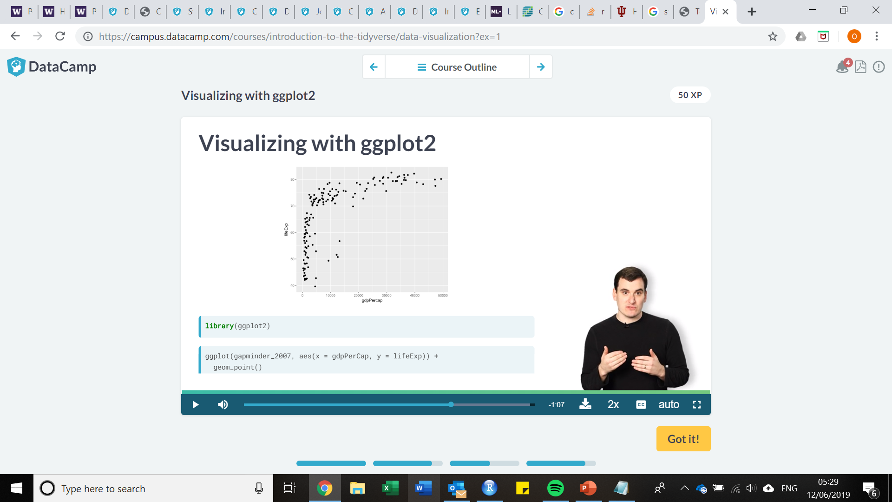
Scatter plots
Three parts to ggplot
First call is dataframe, here == gapminder_2007
Aesthetic, aes(), where calls vary depending on plot type, here is x and y
Plot type, here is geom_point()

Slide 21
Log scales in plots
Notice how alot of countries get crammed close to y axis
This is because the distribution of gdp per capita has several orders of magnitude
Some countries in 10s of thousands of dollars and others in the 100s,
In this case, when values grouped close to axi, useful to use log scale where each fixed distance represents a multiplication of the value.

Slide 22
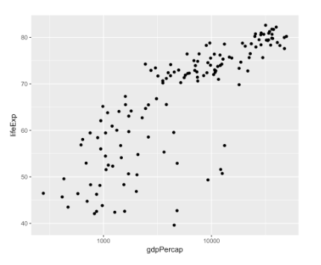
Log scales in plots
Notice how alot of countries get crammed close to y axis
This is because the distribution of gdp per capita has several orders of magnitude
Some countries in 10s of thousands of dollars and others in the 100s,
In this case, when values grouped close to axis, useful to use log scale where each fixed distance represents a multiplication of the value. Add in + scale_x_log10()

Slide 23
Additional calls in ggplot2
AS you will see in the practical, color = and size = can be added to the aesthetic to add more information to a plot
In addition, adding in calls ylab(“Insert y axis name here”), xlab(“Insert x axis name here”), ggtitle(“Insert plot title here”), theme_bw() to make the background white are all good add ins to help beautify a plot
facet_wrap(~categorical_variable) allows you to separate plots by categorical variables as well. Feel free to play around with this as well during the practical!

Slide 24
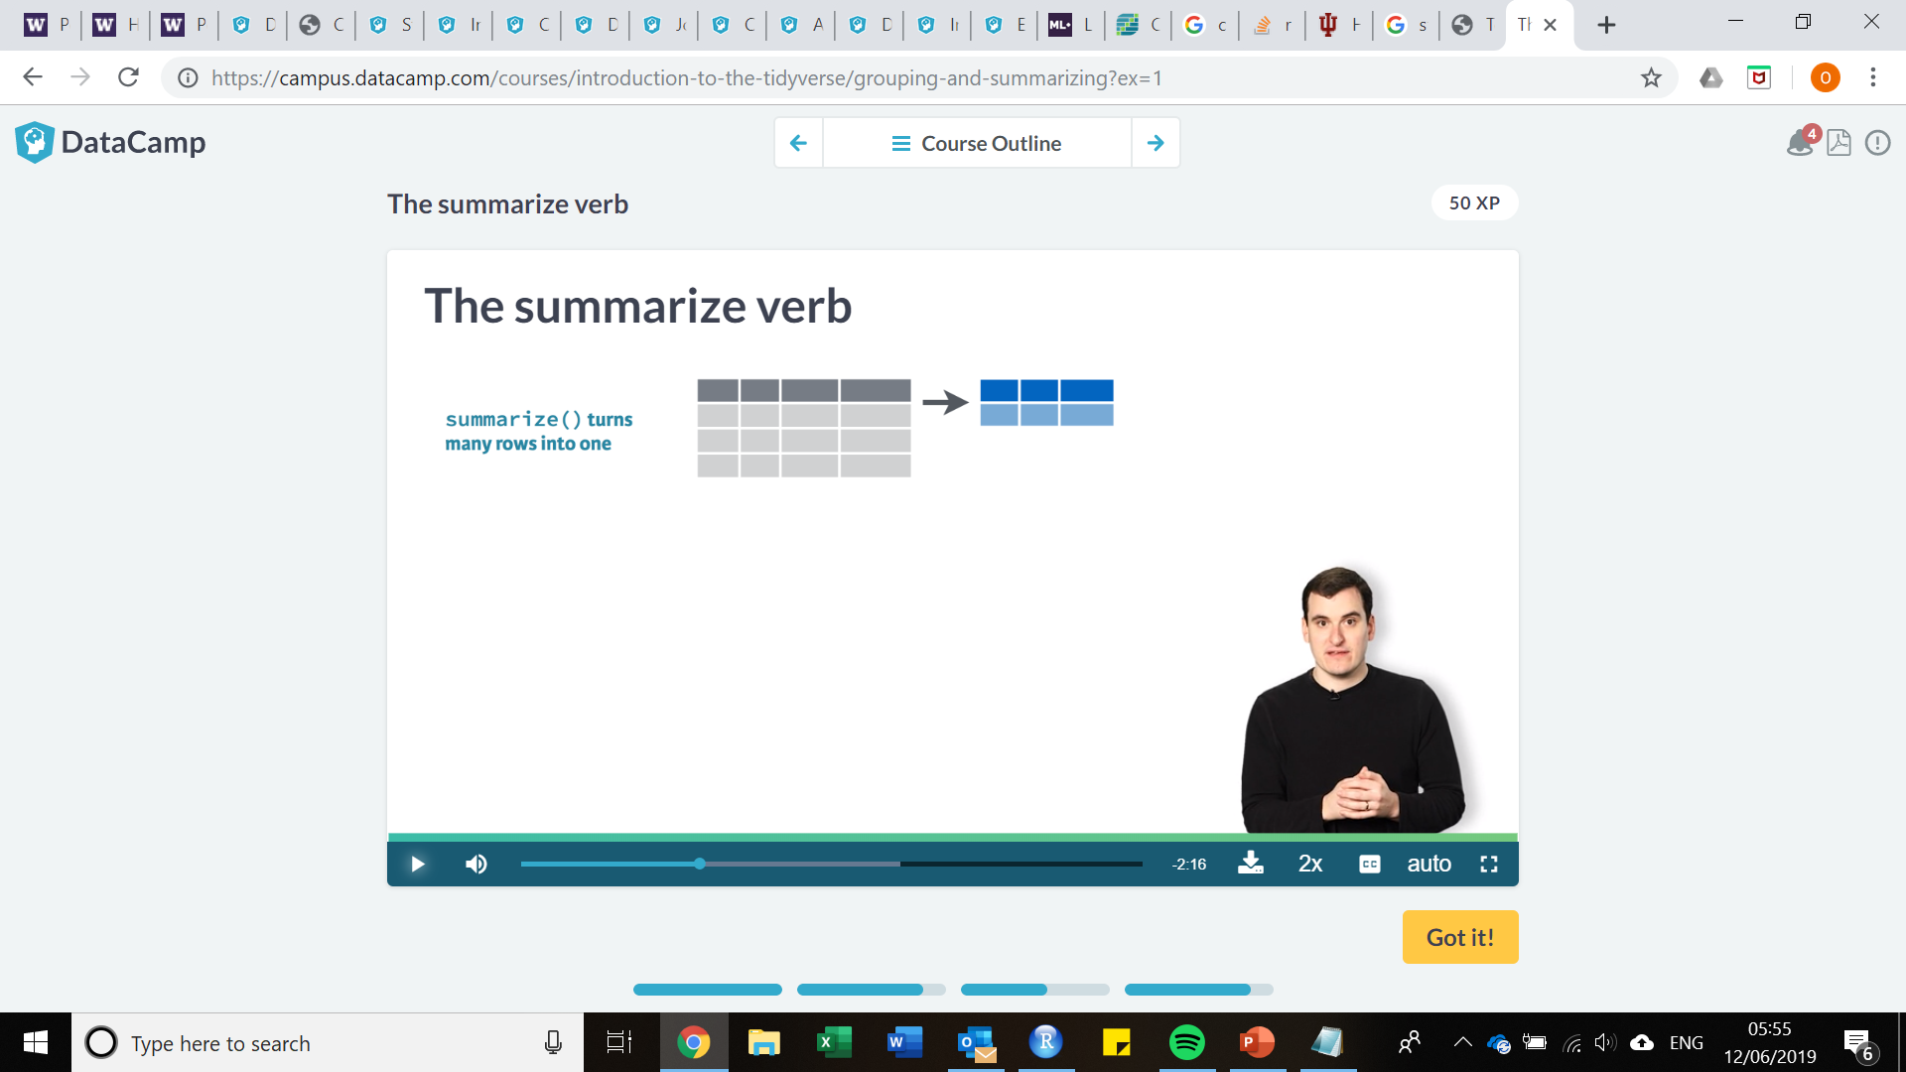
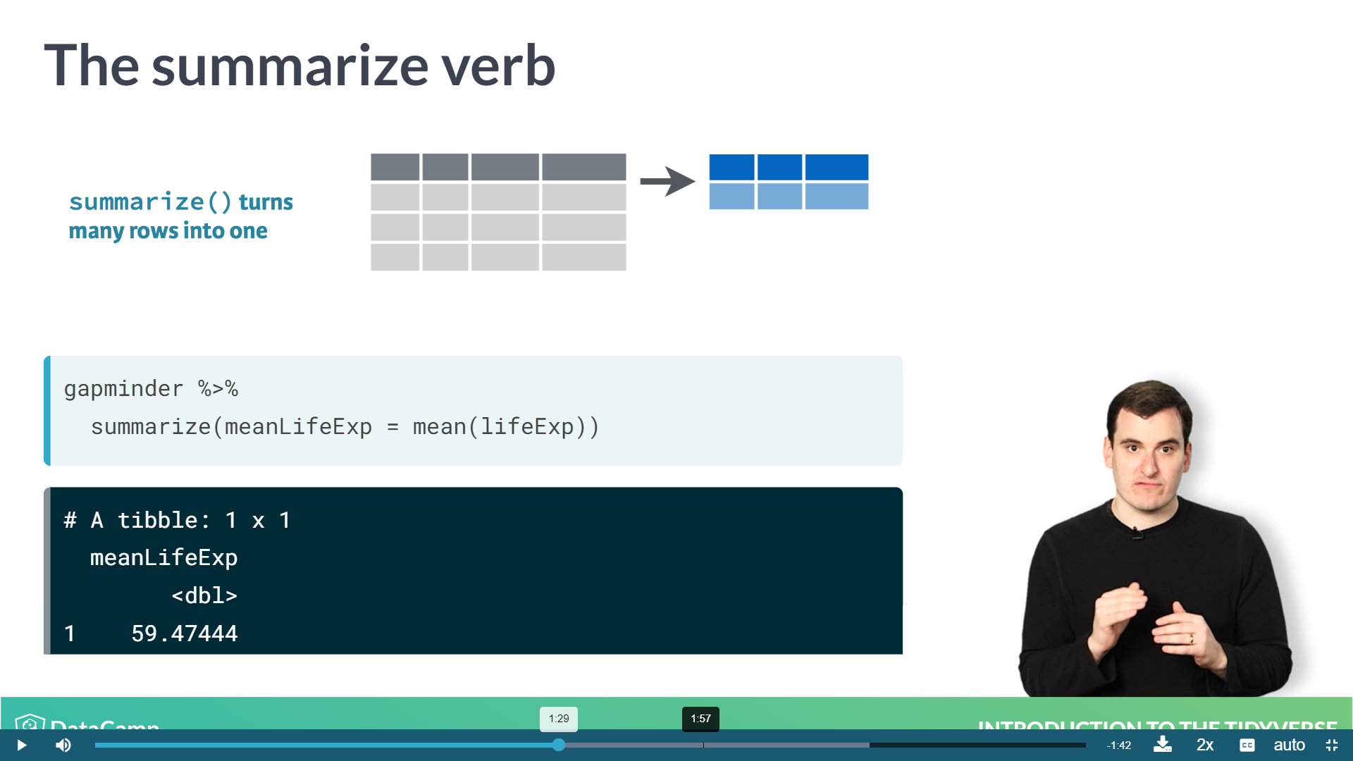
The summarize verb (note the Z!)
Summarize many observations into a single datapoint
E.g. suppose you wanted to know the mean life expectancy across all countries and years

Slide 25
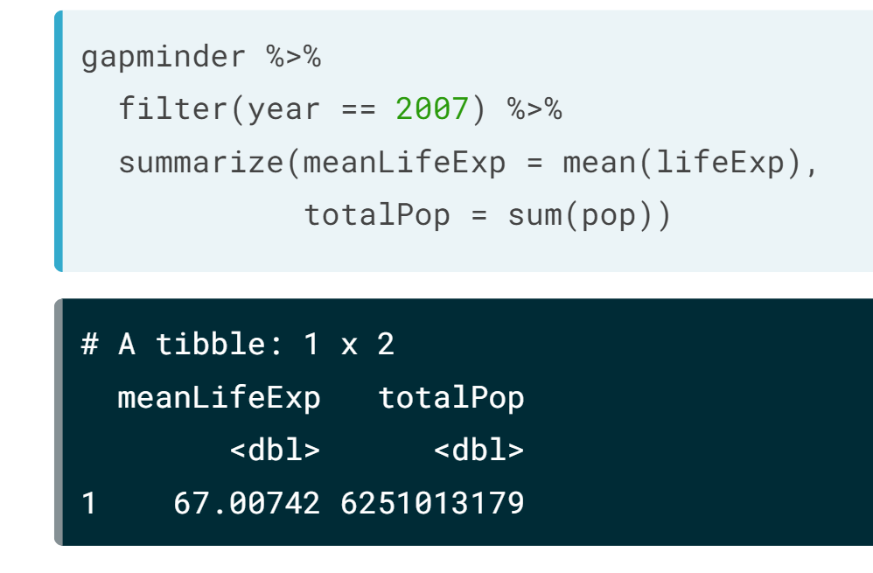
The summarize verb (note the Z!)
Summarize many observations into a single datapoint
E.g. suppose you wanted to know the mean life expectancy across all countries and years
Alternatively, if you wanted to summarize multiple things, do multiple calls

Slide 26
The summarize verb (note the Z!)
Summarize many observations into a single datapoint
E.g. suppose you wanted to know the mean life expectancy across all countries and years
Alternatively, if you wanted to summarize multiple things, do multiple calls
Functions you can use for summarize:
mean
sum
median
min
max

Slide 27
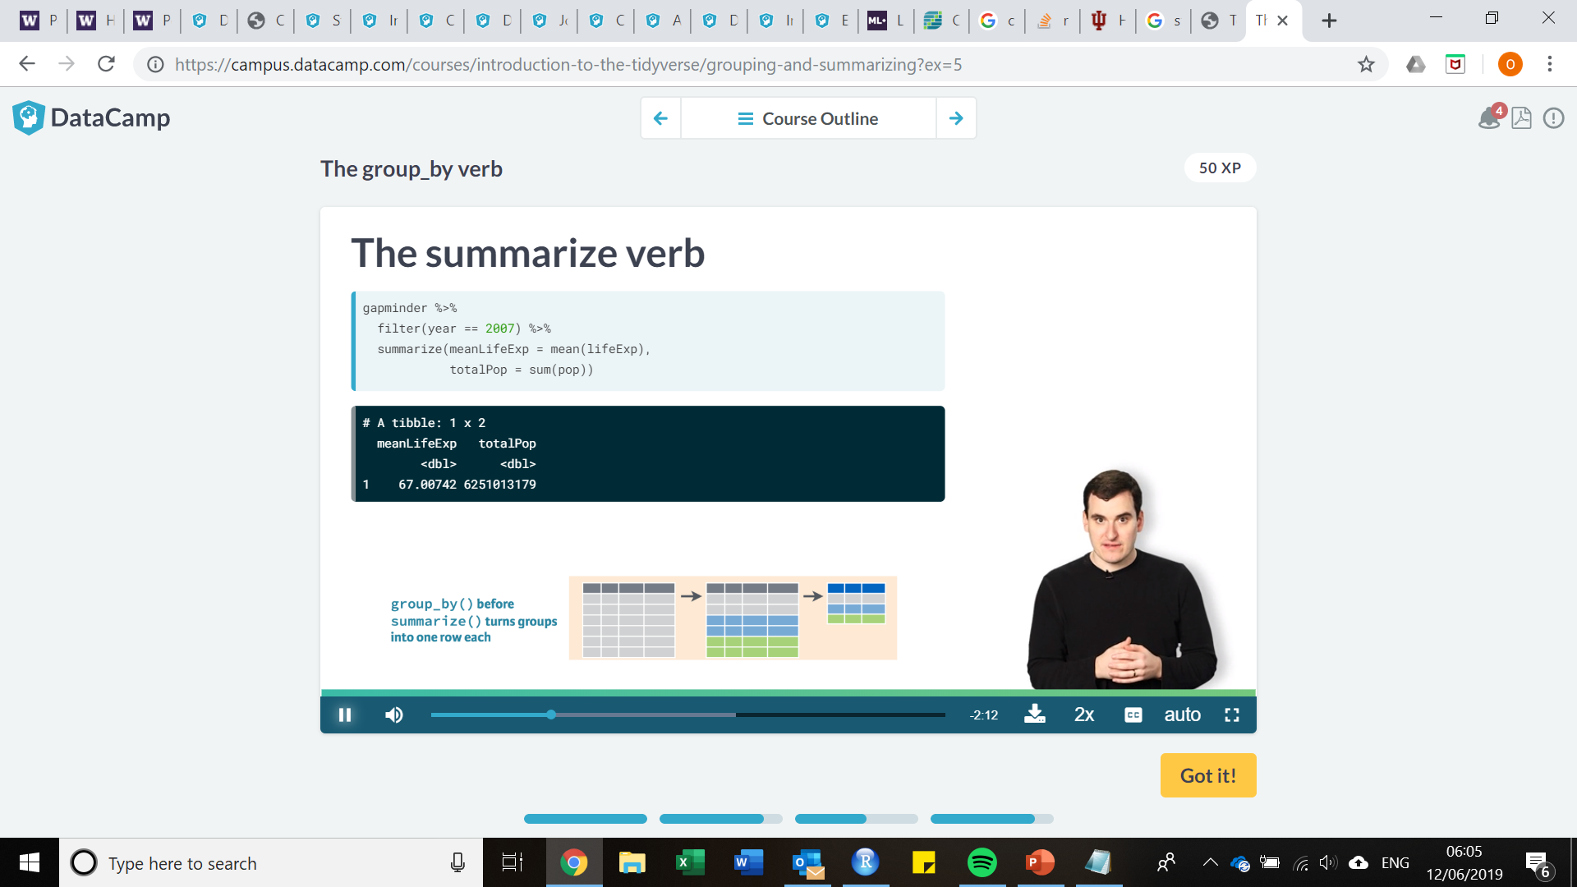
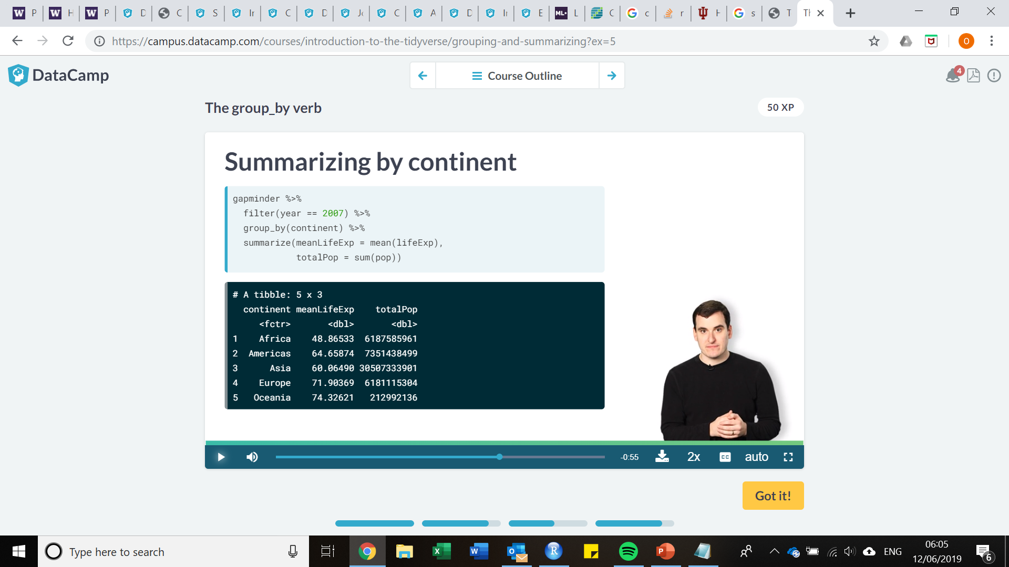
Dplyr: the group_by verb
Allows you to create groups for summarizing
For example, lets say you wanted the mean life expectancy and total population in 2007 by continent

Slide 28
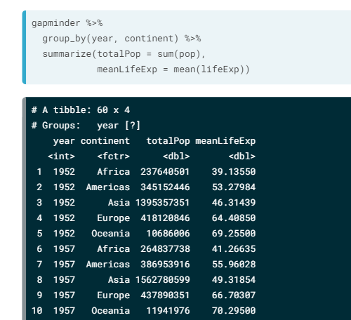
Dplyr: the group_by verb
Allows you to create groups for summarizing
For example, lets say you wanted the mean life expectancy and total population in 2007 by continent
OR summarize year and continent, such that we now have a row for each pair
Back to practical!

Slide 29
Introduction to R/R Studio: Importing, exporting, merging, missing data and duplicates
Smart-R workshop series
Olivia Boyd
o.boyd@imperial.ac.uk
Notes:
30 minutes

Slide 30
Read.csv/write.csv and the csv format
Data from excel, easiest to import as CSV format
dataframename <- read.csv(“file location on drive including name”, header = TRUE)
Be sure to include .csv in filename or it WILL NOT LOAD
Header = TRUE indicates keeping first row of column as variable names
Easiest to set working directory to where data is and just call the datafile name, e.g. “mydata.csv”
Data from R, easiest to import out in CSV format
write.csv(dateframe, “file_name.csv”)
This will save a file to whatever you have set your directed
Be sure to include .csv

Slide 31
Importing other formats of data
If you are bound to keeping excel files in xlsx format (for some unknown reason?) then must load package
install.packages(openxlsx)
library(openxlsx)
dataframename <- read.xlsx(“file\location\name.xlsx”, colNames = TRUE, sheet = 3)
# Allows you to specifiy which sheet within excel spread you would like to use
# colNames = TRUE, same as header = TRUE for csv, variables names = first row
# To write xlsx, use write.xlsx
write.xlsx(dataframename, “name.xlsx”)
# Calls are the same for xls, just replace xlsx with xls in all cases

Slide 32
Importing other formats of data
To import SPSS, Stata or SAS data files in R, need package “foreign”
install.packages(“foreign”)
library(“foreign”)
spssdata <- read.spss(“C:/Documents/spssfile.sav”)
statadata <- read.dta(“C:/Documents/statafile.dta”)
sasdata <- read.xport(“C:/Documents/sasfile.xpt”)
To export in any format, replace read with write and include dataname as first call in parenthesis
write.dta(statadata, “statafile.dta”)

Slide 33
Merging data
Two basic ways of merging data, by rows or by columns
But first! Often good to make a flag variable for datasets which you are planning to merge.
Allows you to be able to identify original datasets once merged.
For this example, three datasets with longitude and latitude data.
SEED = school sites data, variables include long, lat, school.names
CLIN_1 = clinic sites from first study data, variables include long, lat, clinic.sites
CLIN_2 = clinic sites from second study data, variables include long, lat, clinic.sites
Add in flag variable to all three called site_type

Slide 34
Flag variables
#libraries needed
library(dplyr)
#load data
setwd(“C:/Users/ohbon/Documents/results”)
SEED <- read.csv(“SEED.csv”, header = TRUE)
CLIN1 <- read.csv(“results1.csv”, header = TRUE)
CLIN2 <- read.csv(“results2.csv”, header = TRUE)

Slide 35
Flag variables
#the rep function comes back! (repeat)
SEED$site_type <- rep(c("school"), length(SEED_data$long))
CLIN1$site_type <- rep(c(“clinic1”), length(CLIN1$long))
CLIN2$site_type <- rep(c(“clinic2”), length(CLIN2$long))
#make sure you choose a variable that is the full length of the dataframe
#there are many other ways to do this! This is just an example.

Slide 36
Merging clinic site 1 and 2 by columns
#Want to match by clinic site name
both_clinics <- merge(CLIN1, CLIN2, by = “clinic.sites”)
#Some clinics missing from Clinic 2 and merging variables with different #column names in data?
both_clinics <- merge(CLIN1, CLIN2, by.x=“clinic.names", by.y=“clinic.sites", all.x = TRUE)
# makes clinic.sites fill in rows from CLIN2 with NA where clinic 2 is missing sites that appear in clinic 1.

Slide 37
Merging by rows
Easiest method, match names of columns that you want to match between dataframes, select those columns and bind
Fill in other unmatched columns with NA if you want to keep
setdiff() adds in the variables missing from seed, fills with NA
Solely adding them in for matching purposes.
SEED[setdiff(names(both_clinics), names(SEED))] <- NA
both_clinics[setdiff(names(SEED_data), names(Merged))] <- NA
new_merge <- rbind(SEED,both_clinics)

Slide 38
Merging data
Just two examples of many
Depending on the scenario, best method may vary
In general, rbind(), cbind(), merge() are all relatively straightforward
Look up their help scripts for reference!
Alternatively, the join() family is also useful, more advanced methods (beyond the scope of today)
Options include inner_join(), outer_join(), upper_join(), etc. with more calls to specify within
Check out their help documents!

Slide 39
Missing variables – very straight forward
Use ! in dplyr when filtering to exclude NA e.g. filter(!is.na(variable))
Otherwise, many options for dealing with missing variables:
Testing for missing values
table(is.na(mydata$v1))
# returns table of TRUE FALSE for number of missing variables
Recoding values to missing
#Recode 99 to missing for variable v1
mydata$v1[mydata$v1 == 99] <- NA
Excluding values from analysis
mean(mydata$v1, na.rm = TRUE)

Slide 40
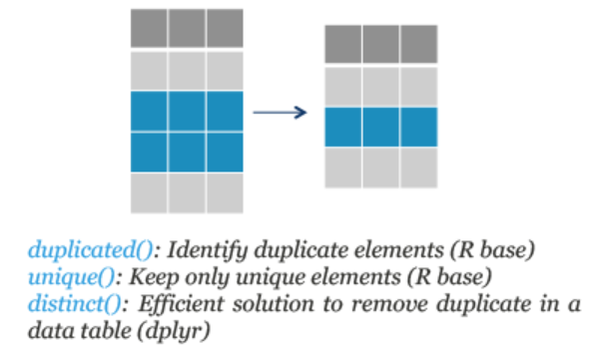
Duplicates in data – very straight forward
Duplicated() finds and drops duplicated elements
mydata[!duplicated(mydata$v1),]
# removes duplicates based on variable
Remove duplicated rows in df with distinct()
mydata %>% distinct()
Remove duplicated rows based on certain columns
mydata %>% distinct(v1, v2, .keep_all = TRUE)
Unique() identifies all unique values in variable, very useful in adjunct with sort() and table()
table(unique(mydata$v1))

Slide 41
Ifelse(), a powerful survey analysis tool
Provides an easy mechanism to group variables for further manipulation. Works as ifelse( if this, this_value, else_this)
Mydata <- mydata %>%
mutate(ages_new <- ifelse(age <= 25, 0, 1)
# can build higher layers, incorporate multiple variables, etc.
Mydata <- mydata %>%
mutate(ages_new <- ifelse((age <= 25 | age > 50) & sex == female, 1, ifelse(age <= 25 | age > 50) & sex == male, 2, 0))
So on so forth…

Slide 42
Get creative with your code
Subsetting dataframes and dplyr are both very powerful tools for cleaning, manipulating and merging dataframes
Understanding how to subset and action verbs available can save you a lot of time
Try things out before looking it up online; you never know what might work and it is truly the best way to learn
However, many resources available….
Rstudio one page cheatsheets
Hadley Wickham’s book “R for Data Science” (the creater of R and dplyr/ggplot2/tidyverse)
Other online tools, email me and ask if interested!

Slide 43
Introduction to R/R Studio: Dates and times
Smart-R workshop series
Olivia Boyd
o.boyd@imperial.ac.uk

Slide 44
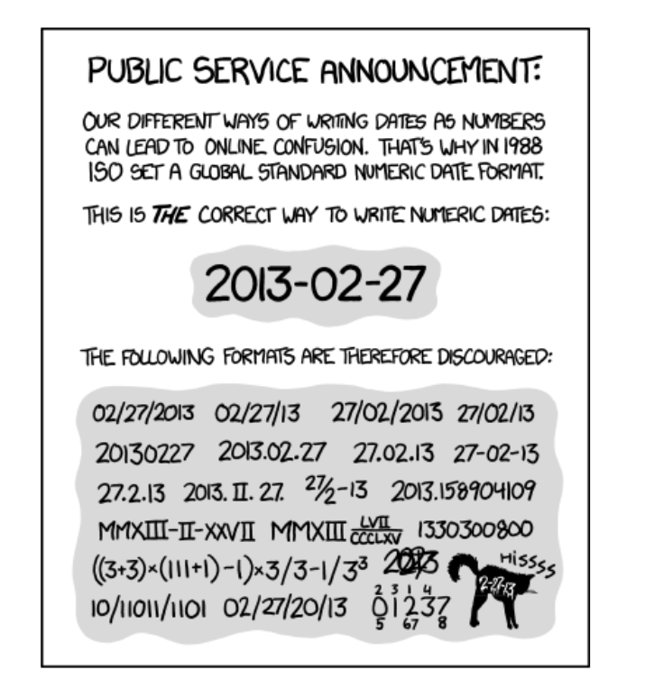
ISO 8601 – The Global Standard
How Canada types dates:
27-02-2013
How the US types dates:
02-27-2013
The global standard:
Values ordered from largest to smallest unit
Fixed number of digits; commence with leading zeros when necessary
e.g. 2nd of March, 2013 = 2013-03-02
Either no separator or “-” in dates
Notes:
International organization for standardization

Slide 45
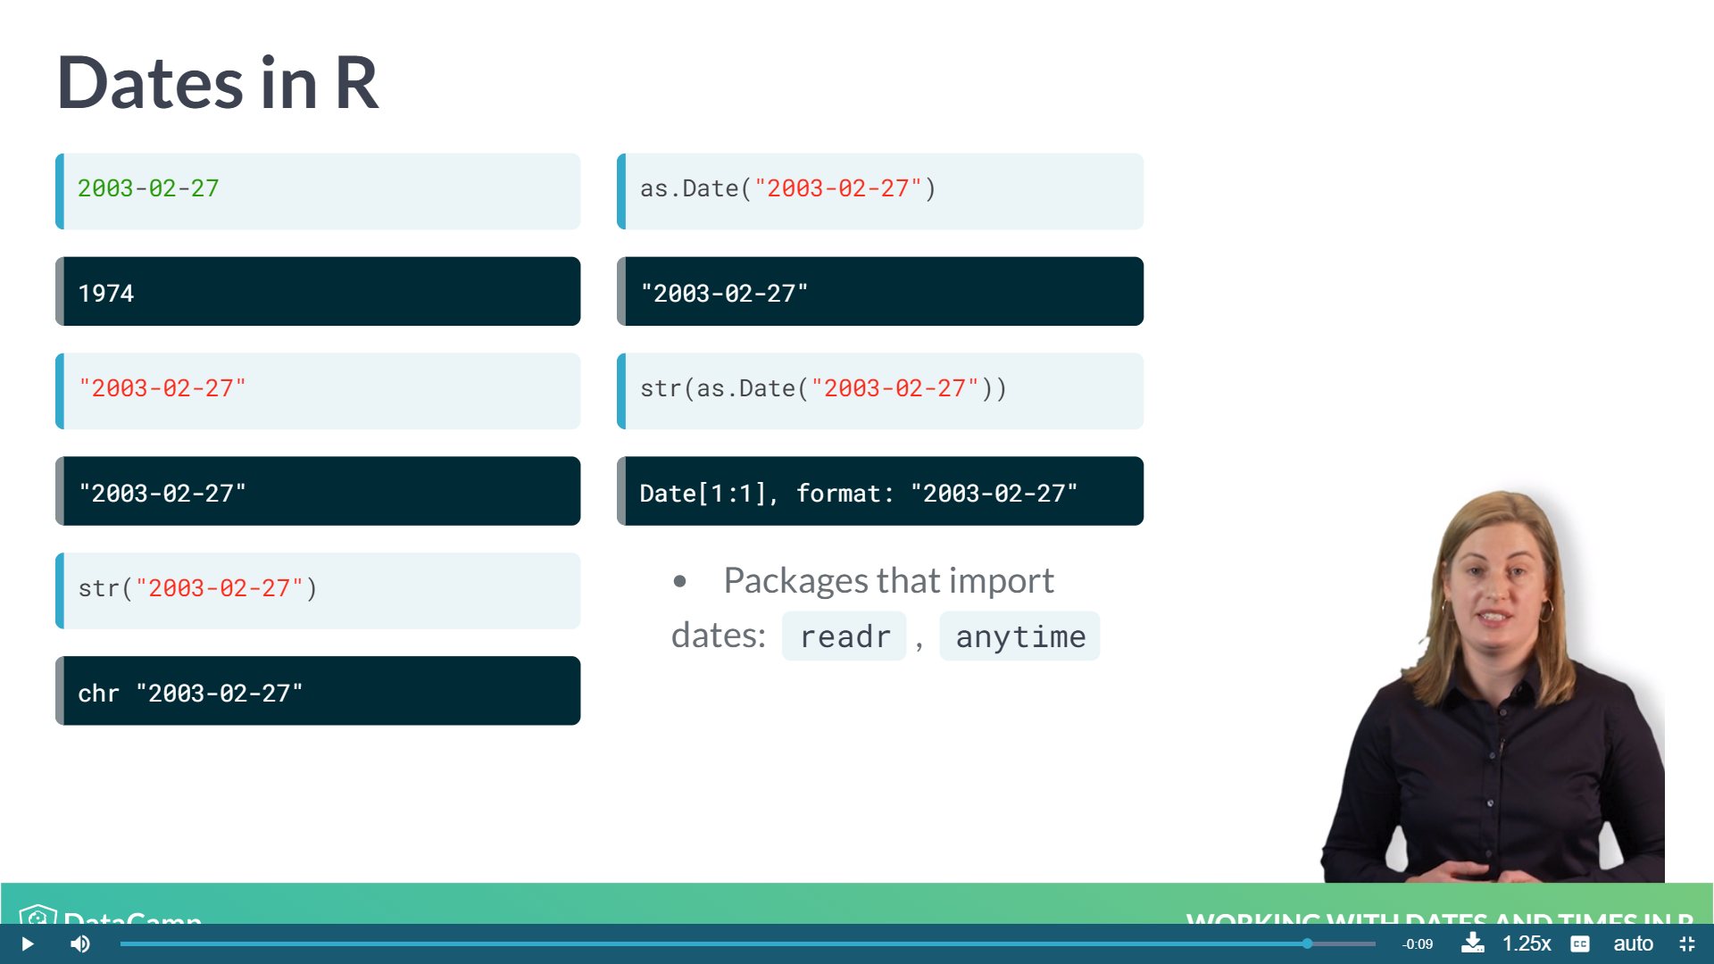
Dates in R
As date?
Subtraction!
As character?
Character value!
Then how?!
As string?
Character string!

Slide 46
Dates in R
Tell R it is a date value…
Notes:
Add in lubridate package here

Slide 47
Packages that import/parse immediately
Readr package
Package designed to recognize and parse dates in a variety of formats.
read_csv(), recognizes dates from imported data (not the same as read.csv()! )
N.B. - dates in 12-06-2010 format can be tricky here:
Does it stand for December 6th 2010 or June 12th 2010?
Anytime package
anytime() function can automatically parse strings as dates, regardless of format
# Load the anytime package
library(anytime)
# Various ways of writing Sep 10 2009
sep_10_2009 <- c("September 10 2009", "2009-09-10", "10 Sep 2009", "09-10-2009")
[1] "2009-09-10 01:00:00 BST“ "2009-09-10 01:00:00 BST" "2009-09-10 01:00:00 BST“
[4] "2009-09-10 01:00:00 BST“

Slide 48
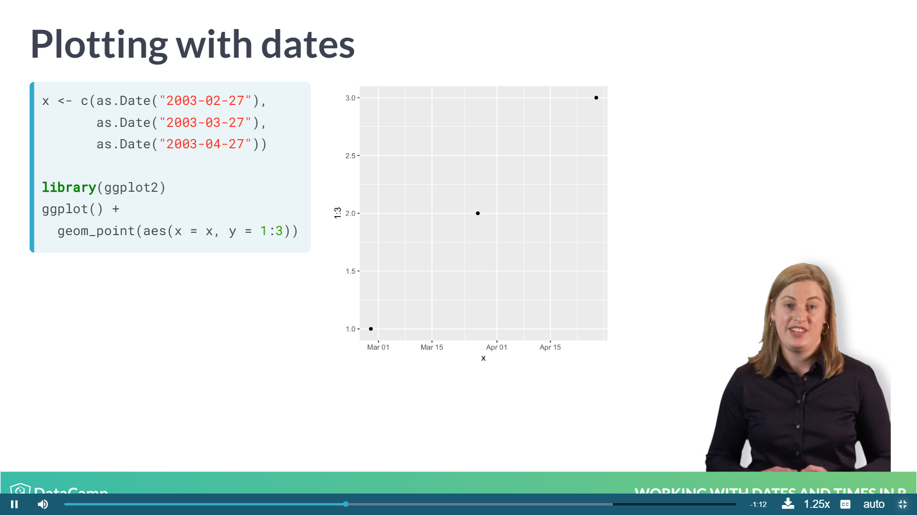
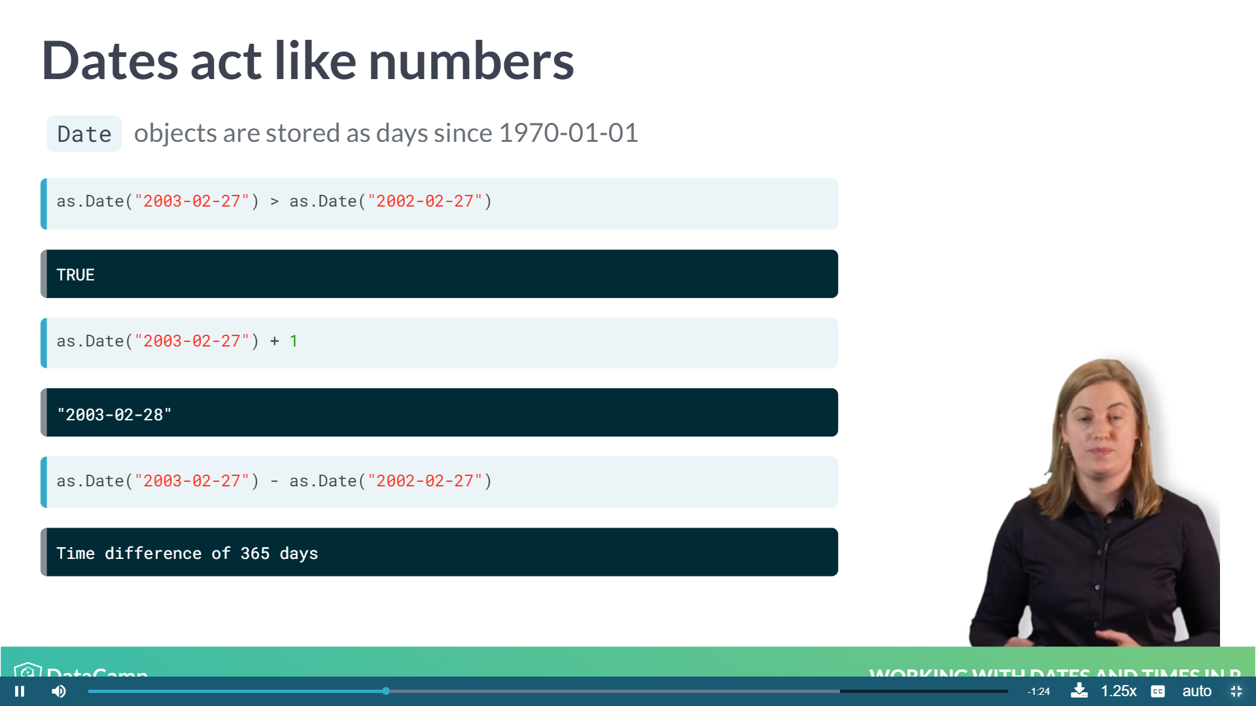
Dates = numbers in R
Manipulating dates
Stored as days since 1970-01-01 (it’s a Unix thing)
Sys.Dat() gives current date (try this now!)
Subtracting date from Sys.Dat gives # days ago
Can manipulate and plot dates like numbers
Logical
Addition
Subtraction

Slide 49
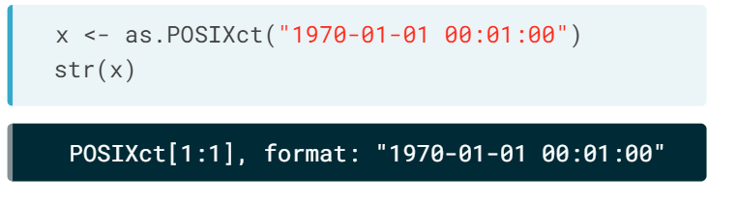
ISO 8601 – Again
Largest unit to smallest
- Fixed digits of HH:MM:SS where (0-24):(0-59):(0-59)
Again, either no separator or : is used
If combined with date, sometimes prefixed with character t
- Two object types
- POSIXlt – list with named components
- POXIXct – seconds since 1970-01-01 00:00:00
*** goes straight into data frame ***
as.POSIXct() turns string into POSIXct object
*Must be in ISO 8601 format, otherwise manipulation needed

Slide 50
Time zones
No timezone specified, assume local time
UTC is specified by :00Z
Universal time that doesn’t observe day light savings
Subtracting from local time will change to different timezone
Can specify time zone with tz argument.
as.POSIXct("2016-05-15T18:00:00Z")
[1] "2016-05-15 BST“
[1] "2016-05-15 UTC"
as.POSIXct("2016-05-15T18:00:00Z", tz = "UTC")
Notes:
11 minutes to here

Slide 51
Lubridate
#Load lubridate
library(lubridate)
#Various orders of inputs
ymd("2013-02-27")
mdy("02-27-2013")
dmy("27-02-2013")
Makes working with dates and times in R easy!
tidyverse package (which you know all about now!)
Works well with other tidyverse packages
Works with multiple different date/time formats
Can use parse date time for odd orders (e.g. dym)
[1] "2013-02-27“
[1] "2013-02-27"
[1] "2013-02-27"
# Character input manipulation
parse_date_time(c("February 27th 2013", "27th February 2013"), order = c("mdy", "dmy"))
[1] "2013-02-27 GMT" "2013-02-27 GMT"

Slide 52
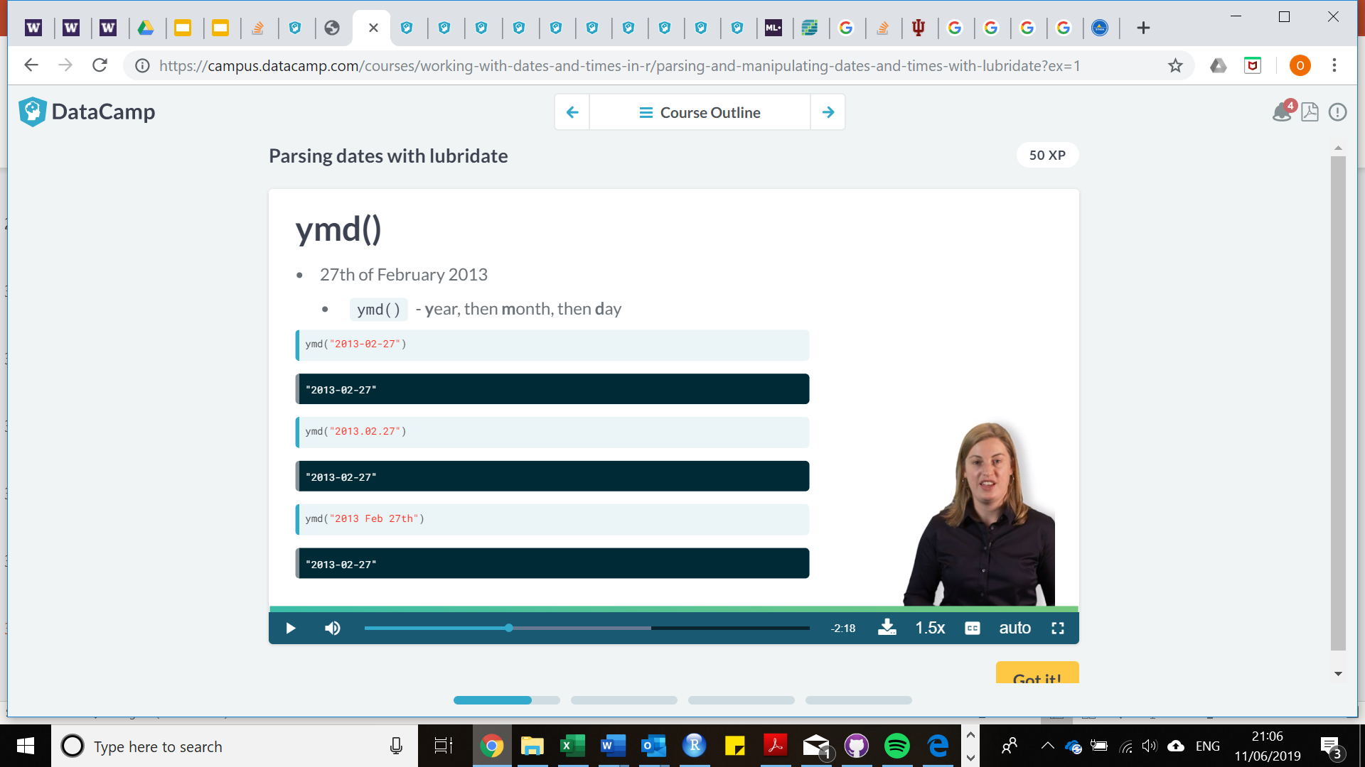
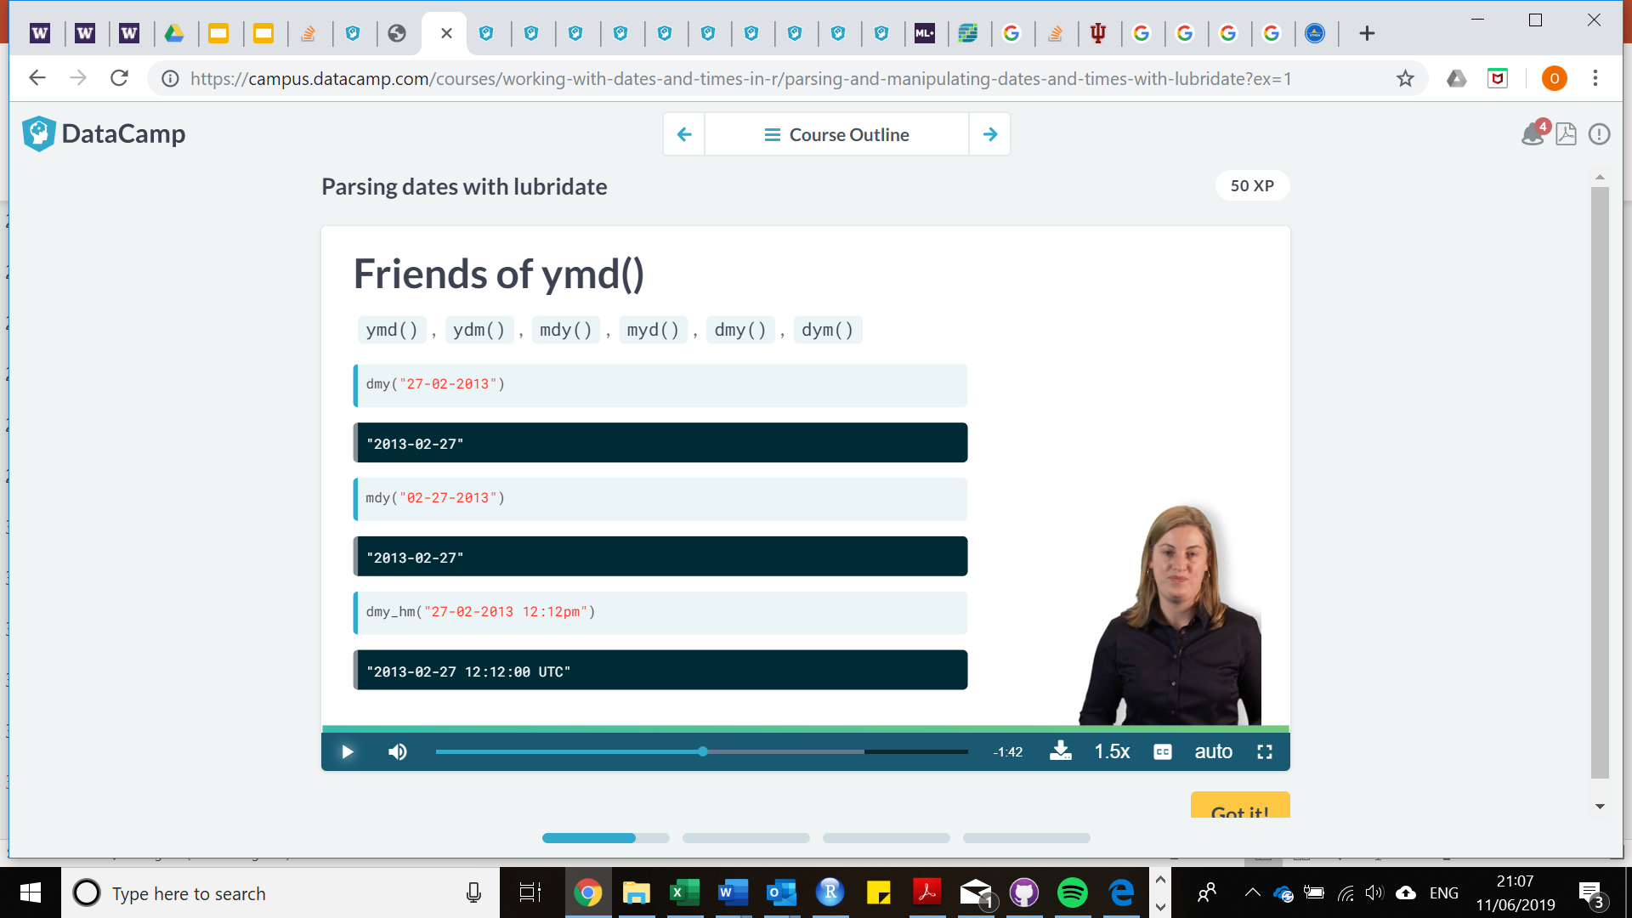
ymd() and friends!
Notes:
* Note UTC is specified here

Slide 53
difftime()
Identify the difference in time between two dates
e.g. attendance at clinic, time between samples taken, etc
Units include: “secs”, “mins”, “hours”, “days”, “weeks”
- As such, can be more specific with what type of difference time you would like to calculate between two variables

Slide 54
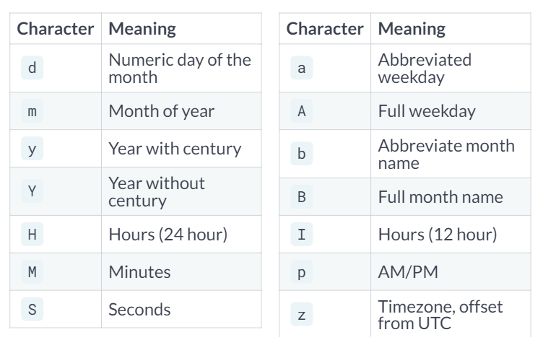
?parse_date_time(), let’s practice!

Slide 55
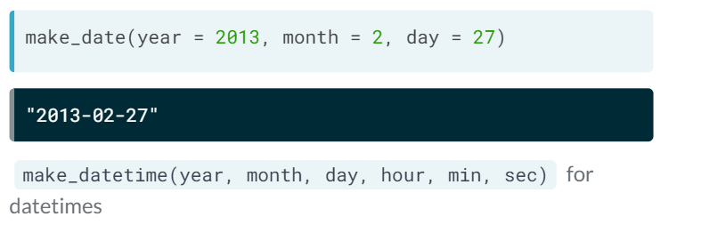
make_date()
make_date() is useful when date variables are spread across a data frame
E.g. if you had a column for year, a column for month and a column for day, you can use make_date() within a mutate pipe (remember %>%) to create a variable which combines these three columns together

Slide 56
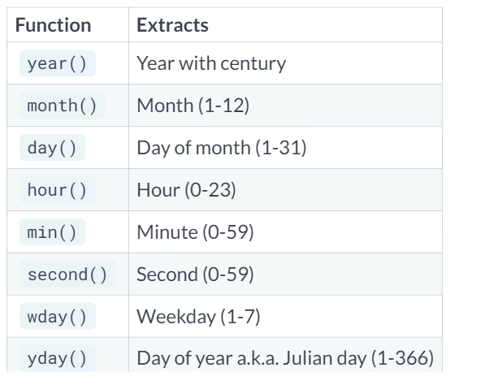
Extracting portions of date/time
x <- ymd("2013 February 27th")
year(x)
month(x)
day(x)
> year(x)
[1] 2013
> month(x)
[1] 2
> day(x)
[1] 27

Slide 57
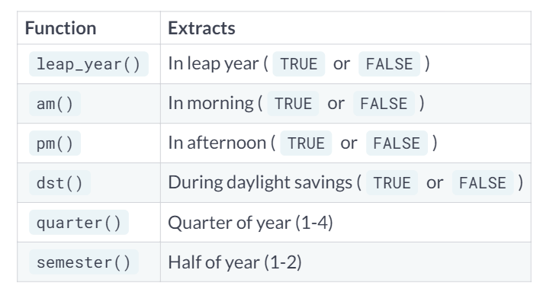
Extracting portions of date/time

Slide 58
Additional functions in lubridate
Rounding:
round_date() rounds to nearest value
floor_date() rounds down
ceiling_date() rounds up
You can specify “second”, “minute”, “hour”, “day”, “week”, “month”, “bimonth”, “quarter”, “halfyear”, or “year”
OR any multiple of these, e.g. “2 years” or “30 minutes”
Rounding is useful since rather than extracting, e.g. extracting hours, you still retain the whole time unit

Slide 59
Time spans in lubridate: Period and Duration
Period
Human concept of a time span
Datetime + period of one day = same time on the next date
Variable length
Duration
Stopwatch concept of time span
Datetime + duration of one day = 86400 seconds
Fixed number of seconds
mar_11 <- ymd_hms("2017-03-11 12:00:00",
tz = "America/Los_Angeles")
mar_12 <- ymd_hms("2017-03-12 12:00:00",
tz = "America/Los_Angeles")
mar_13 <- ymd_hms("2017-03-13 12:00:00",
tz = "America/Los_Angeles")
# Difference between mar_13 and mar_12 in seconds
difftime(mar_13, mar_12, units = "secs")
# Difference between mar_12 and mar_11 in seconds
difftime(mar_12, mar_11, units = "secs")
difftime(mar_13, mar_12, units = "secs")
Time difference of 86400 secs
> difftime(mar_12, mar_11, units = "secs")
Time difference of 82800 secs

Slide 60
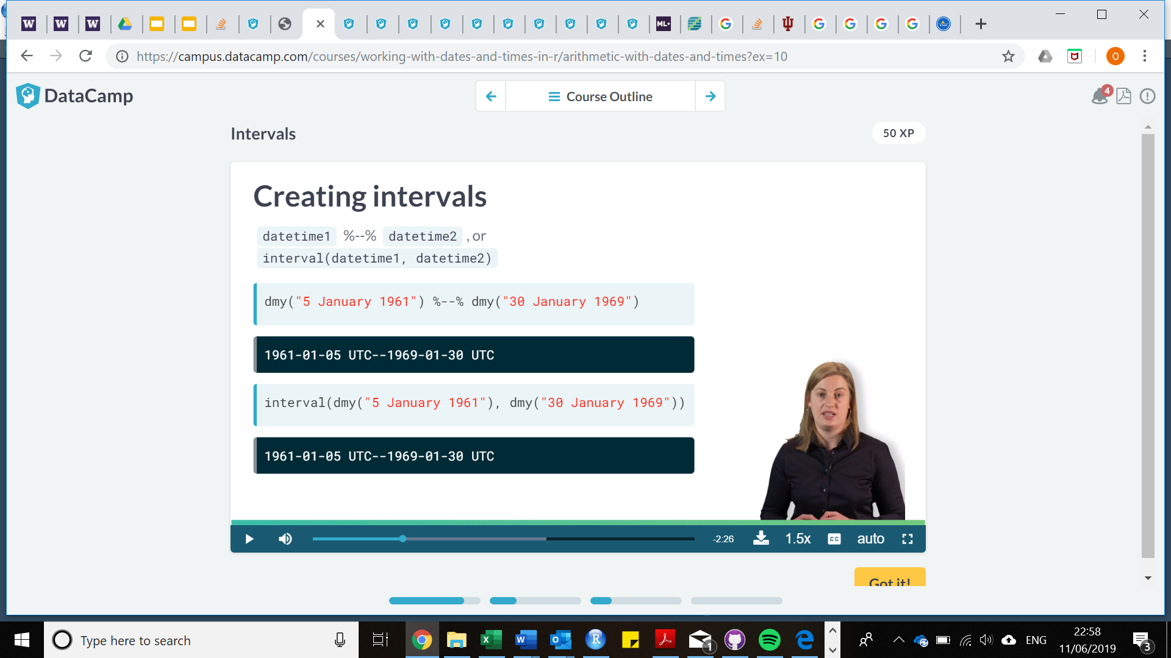
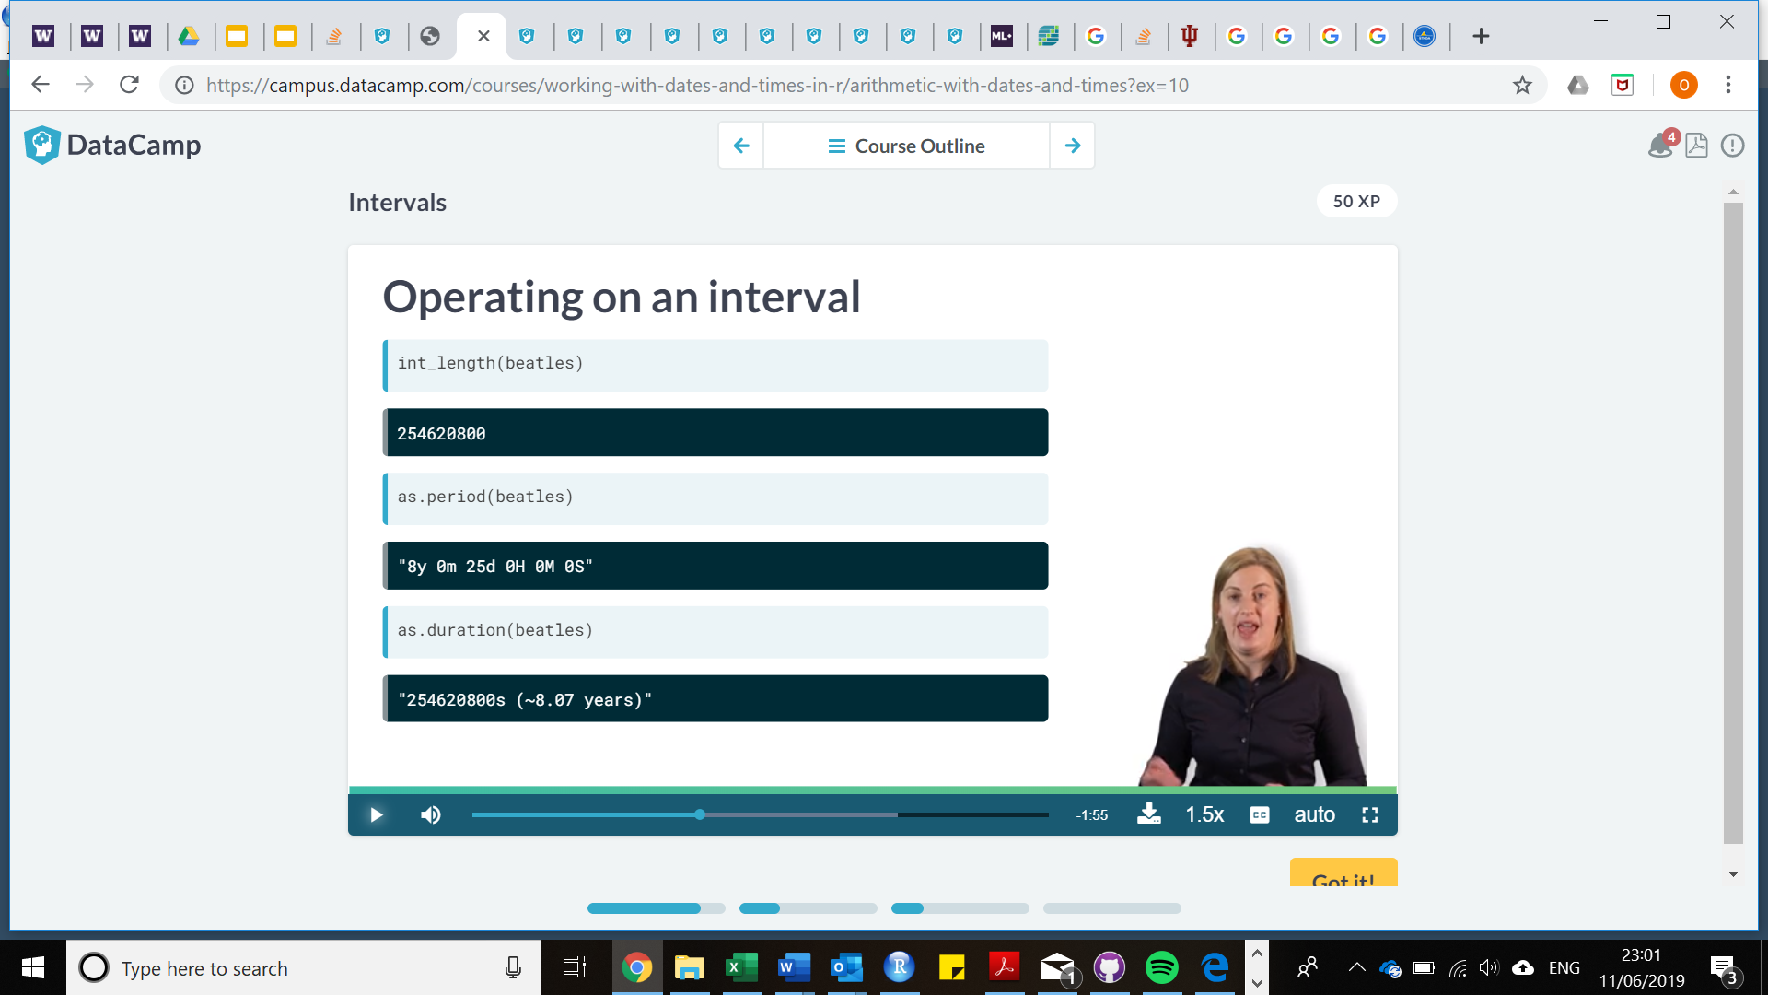
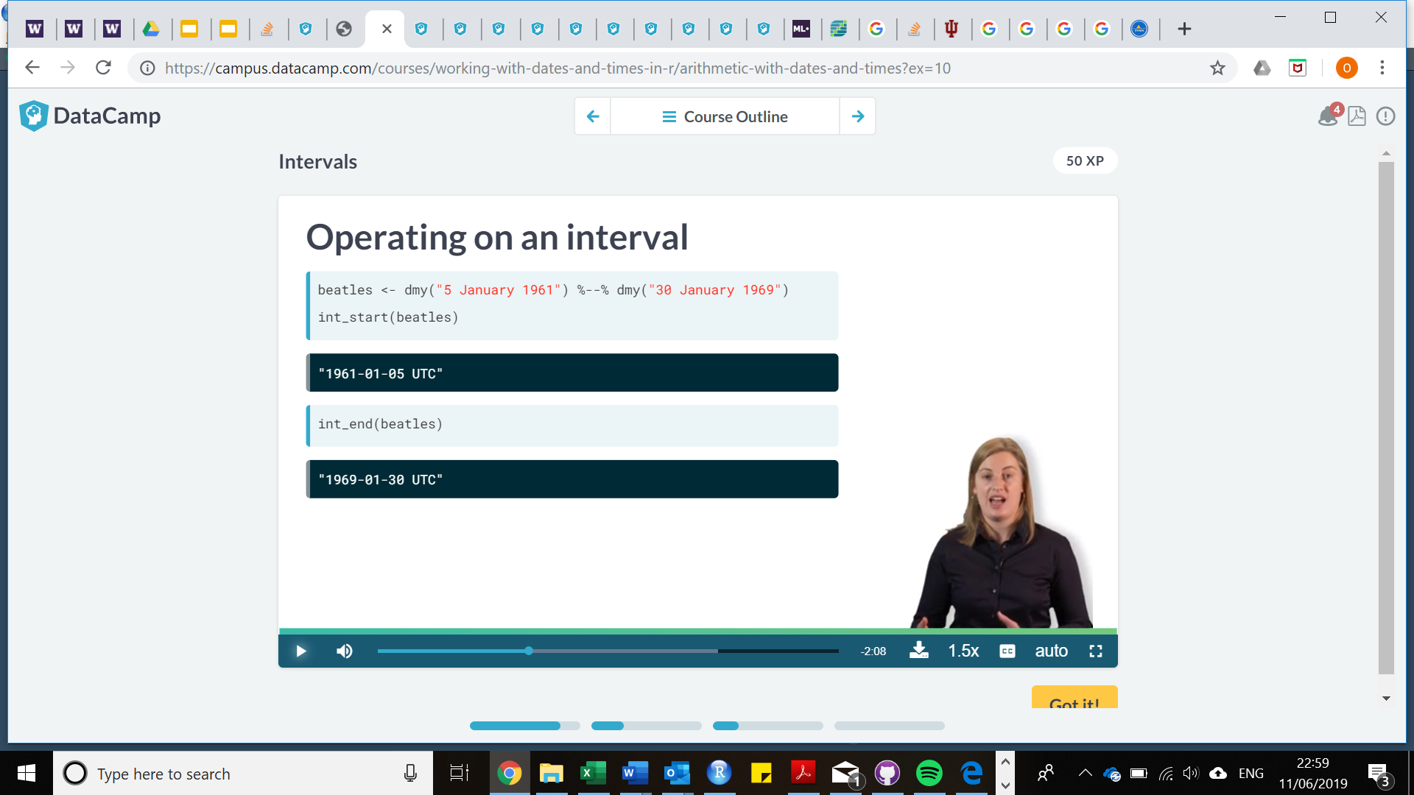
Time spans in lubridate: Intervals
Use:
Intervals when you have a start and end point
Durations if you are interested in seconds elapsed
Periods if you are interested in human units (DLS, leap years, etc.)

Slide 61
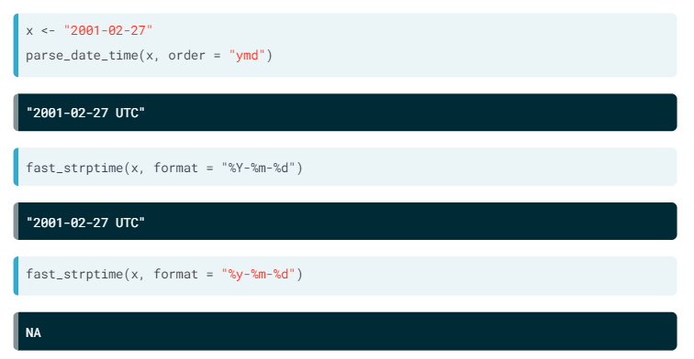
Fast parsing with fast_strptime()
When you’re working with big data, are you have data that has unusual formatting, parse_date_time() might not be your best bet
fast_strptime() provides MANY more different options for identifying date time formats
However, fast_strptime() is much more particular, you have to match the characters exactly otherwise NA will occur
See ?fast_strptime() for specifics….
There are a lot of different % options, even I don’t know them all!

Slide 62
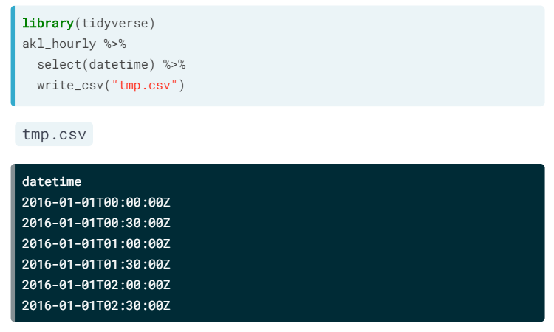
Exporting date time data
Same method as introduced before!
For any dataframes or variables you can use write_csv() to export data for viewing in excel or for future use in R
Just like before, use tidyverse functions to select variables you want to export

Slide 63
Conclusions
What have we covered today?
The basics, what is R/R studio and how to use it
Tidyverse and manipulating data; merging, importing and exporting dataframes
The basics of ggplot2, data visualization
Introduction to date and time variables
Further topics to build on this
Using ggplot2 and other packages for advanced visualisations
Statistical analyses
Functions, loops and the whole nine yards!
Advanced programming methods in R

Slide 64

Conclusions
Keep working at it! R is a language that takes time to learn, but the pay off is well worth it.
Thank you for attending! Please send any comments and questions to:
o.boyd@imperial.ac.uk
oliver.geffenobregon@phe.gov.uk
We look forward to hearing from you!
Special thanks to David!

